Slide 1

DoorDash

Slide 2

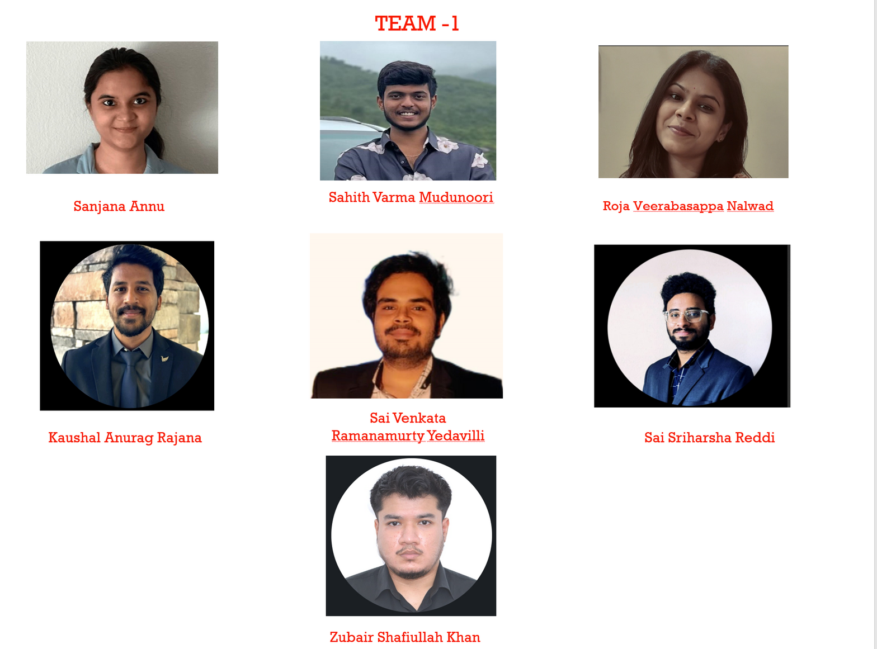
MAVERICKS

Slide 3
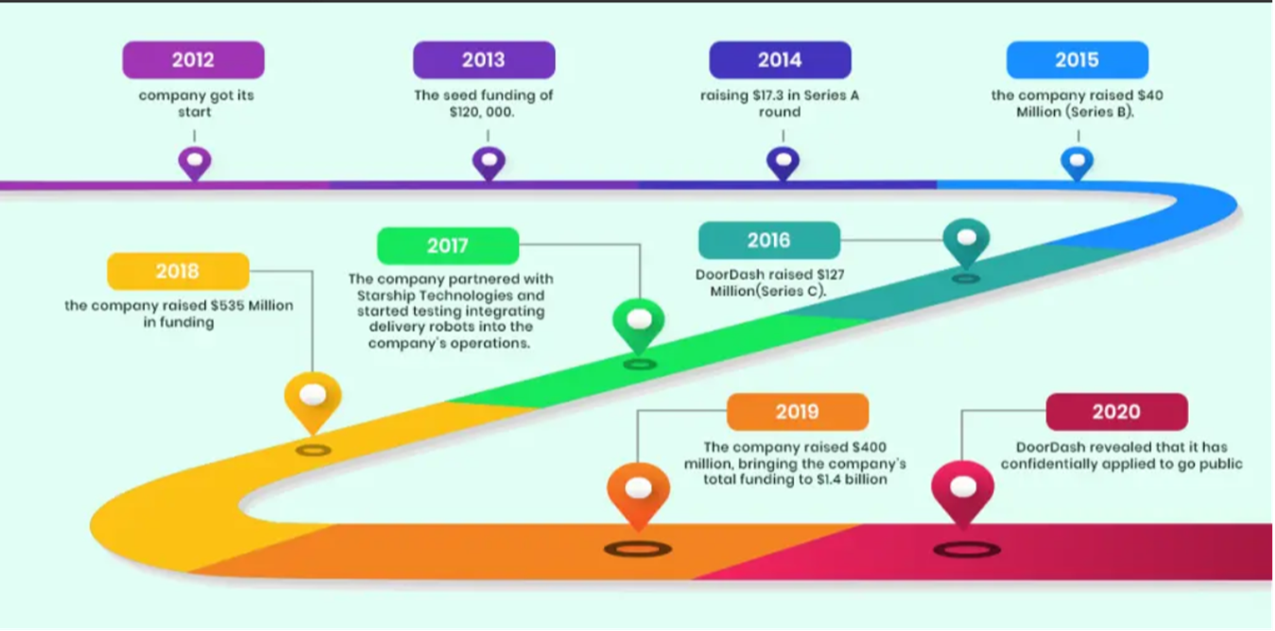
Brief History

Slide 4
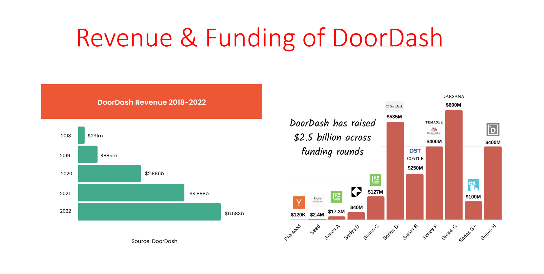

Slide 5

Aquisitions / Events
ROADMAP
FeAtures
Revenue
DoorDash launched its food delivery platform in Palo Alto, California.
Expanding to new cities and markets across the United States.
Initially, the platform focused on providing restaurant food delivery service﻿s
Estimated annual revenue in the millions of dollars.
2013 -2014
Early Growth and Expansion
No major acquisitions during this period.
Expanding to more cities across the U.S., with a growing restaurant partner network.
2015- 2016
Expanding Services and Markets
DoorDash launches its first food delivery service in the San Francisco Bay Area.
Introduction of mobile apps for both iOS and Android.
Enhancements to the user interface and ordering process.
Estimated annual revenue in the range of $100 million to $200 million.
2017- 2018
Rapid Growth and Merchant Partnerships
Expanding partnerships with national and local restaurant chains.
D﻿oordash hit 1 million deliveries and began signing big chains like Wendy’s, Taco bell etc.
Introduction of "DoorDash Drive”, “DashPass” allowing businesses to use DoorDash's platform for their own deliveries.
Improved user experience and order tracking.
Goes global
Estimated annual revenue surpassing $1 billion in 2018

Slide 6
ROADMAP
Aquisitions / Events
FeAtures
Revenue
Features
Estimated annual revenue in the range of $2.4 billion (2019) to $3.5 billion (2020) due to increased demand during the COVID-19 pandemic.
Acquisition of Caviar (August 2019) for approximately $410 million.
Expansion into new markets and international expansion.
Its started trading on NYSE on Dec.9 and became a public company and valued the company at 72$ Billio﻿n.
Expansion into grocery delivery and convenience store items.
Introduction of "DashMart" and alcohol delivery services.
Enhanced delivery tracking and contactless delivery options.
2019 - 2020 Expansion and Strategic Acquisition
Acquired Wolt ( Finnish based technology food delivery company ) for 8.1 Billion$
Acquired Chowbotics the maker of robot vending machine named “Sally.
DoorDash acquires Caviar, a food delivery service that specializes in fine dining restaurants.
Acquired Food tech start-up Bbot, contact-less ordering and payment platform.
Continued expansion into various delivery categories, including pet supplies, health, and wellness products.
Introduction of subscription services and loyalty programs.
Integration of advanced AI and data analytics for route optimization.
DoorDash raises $250 million in funding, becoming one of the most valuable food delivery startups.
Estimated annual revenue exceeding $5 billion (2021).
2021- 2022 Continued Growth and Market Dominance
Potential strategic acquisitions to strengthen DoorDash's market position.
Expansion into additional international markets.
2023 - Beyond: Future Developments
Expansion of services into emerging markets and new verticals.
Further investment in technology and innovation for delivery efficiency.
Launches major app changes like “Universal search, browse tab, Grocery tab, Retail tab and multiple carts etc.
Working on AI voice powered ordering technology
Projections for revenue growth in 2023 and beyond would depend on market conditions, competition, and strategic initiatives.

Slide 7
Digital Disruption
"Digitized ordering and delivery for efficiency."
Marketplace Model
"Online marketplace connecting customers to restaurants."
Real-Time Tracking
"Real-time order tracking for transparency."
Data-Driven Logistics
"Optimized routes and delivery management."
Dashers Gig Economy
"Flexible gig economy model for drivers."
Partnerships and Diversification
"Collaborations beyond food delivery."
Subscription Services
"DashPass for customer loyalty."
Virtual Kitchens
"Ghost kitchens for efficient food delivery."
Innovation

Slide 8
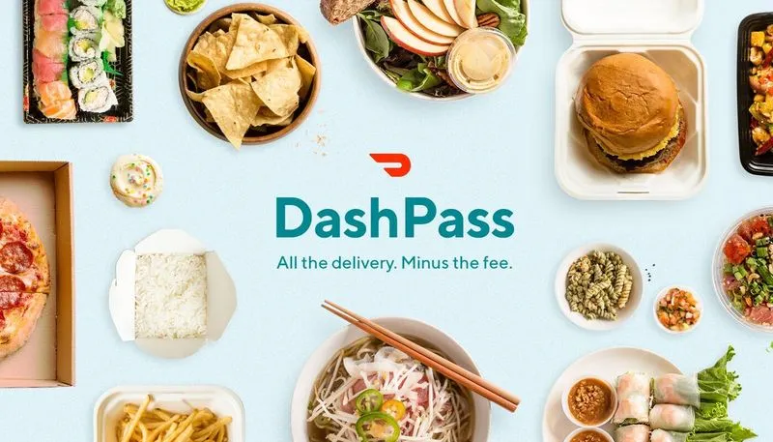
Disruptive Innovation
DashPass: Subscription service for unlimited free delivery
DashMart: Convenience store for same-day delivery
Caviar: High-end food delivery service
DoorDash: Drive: White-label delivery solution for merchants
Liquor Delivery: Door dash was the first delivery service to deliver Alcohol and spirits.

Slide 9
STICKINESS
SEAMLESS
CENTRALIZED VIEW
DASH PASS
PRICING
LOYALTY PROGRAM
DOUBLE DASH
GROUP ORDERS

Slide 10
VALUE CREATION
Features
Customers
Employees
Partners
Convenience
Variety
​
Fast Delivery ​​
Affordable
Safe​ty
Fair compensation
Flexible hours
Growing careers​
Teaching skills​
Healthcare​
Growing Customers​
Advertising​
Delivery Support
Tech Tools​
Customer Feedback​
Easy to use UI​
Grocery & Retail​
Tracking
Transparency
Deals​

Slide 11
Adoption
PARTNERSHIPS WITH MESSAGING APPS
CONTENT MARKETING
DoorDash has created a variety of content, such as blog posts, receipes , and videos , to educate users about the service and to make it more appealing.
DoorDash has partnered with messaging apps to allow users to order food directly within the app.
ONLINE ADVERTISING
APP STORE OPTIMIZATION
Doordash has invested heavily in online advertising such as search engine marketing and social media advertising.
DoorDash has optimized its app store listing for search engines , so that users can easily find the app when they search for food delivery services.

Slide 12
Adoption
WORD-OF-MOUTH
PANDEMIC BOOSTS DOORDASH
DoorDash's success stems from customers recommending the service to friends and family, leveraging trust for effective user acquisition.
DoorDash's adoption has been accelerated by the COVID-19 pandemic. As people have spent more time at home, they have become more reliant on food delivery services.
URBAN DOMINANCE
DOORDASH'S MILLENNIAL MARKET
DoorDash is also popular in urban areas. According to a survey by Nielsen, 60% of DoorDash users live in cities with a population of over 500,000 people.
DoorDash is particularly popular among younger consumers. According to a survey by Statista, 59% of DoorDash users are between the ages of 18 and 34.

Slide 13
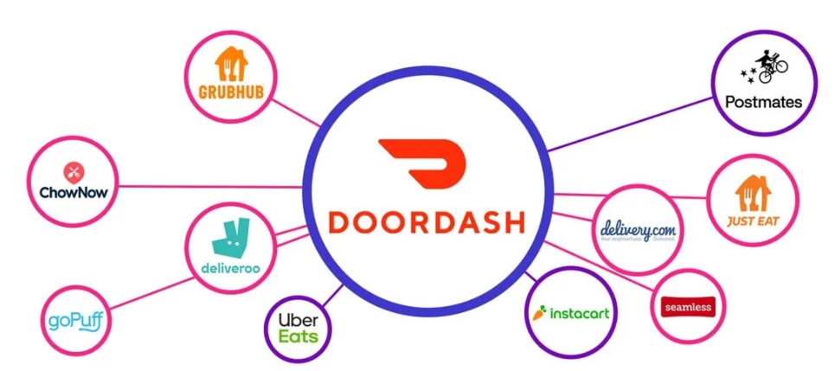
MARKET TYPE

Slide 14
Existing Markets
Give consumers what they require and not copy competitor strategies :
DoorDash has a unique approach of going the extra mile to give customers what they desire. It believes in making short-term sacrifices to maintain its reputation.
Target Audience :
Doordash has targeted the audience of ages between 15-35 , people who would most likely order from outside due to their busy lifestyle.
Emphasis on quality:
Doordash always reviews the restaurant and their quality before it offers those to their customers
Develop direct customer contact:
Develop direct contact with customers pain points to understand their perpective.
Objective is to improve operations by 1% on a daily basis :
Doordash believes in giving customer more value by improving their operations by 1% daily
Easy to use Technology :
Doordash intiutive UI and easy App navigation creates a smooth experience for their customers so that they find it easy to place and an order.

Slide 15
New Markets
TO SERVICE ALL TYPES OF MERCHANTS AND NOT JUST RESTAURANTS﻿.
ACQUISITIONS AND EXPANSIONS, ADVERTISING BUSINESS AND DRIVE LOYALTY PROGRAMS.
DRIVERLESS FUTU﻿RE.
ADAPTING TO VARIOUS TRADITIONS AND CULTURE PREFERENCES OF VARIOUS MARKETS.

Slide 16
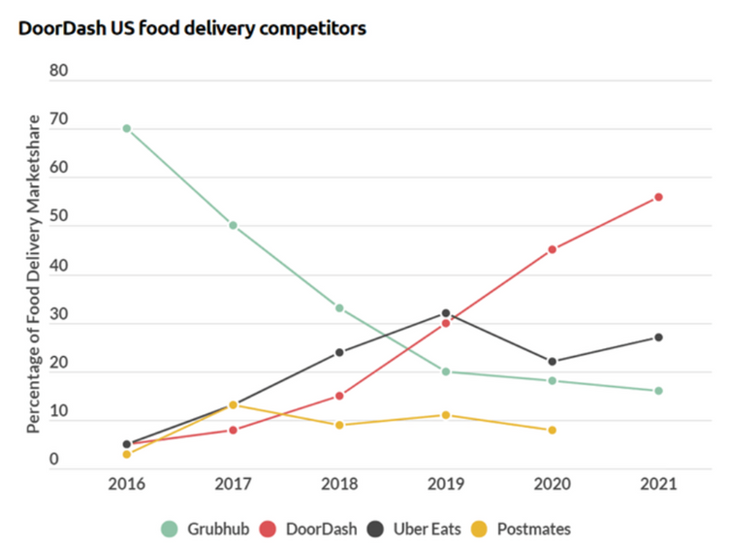
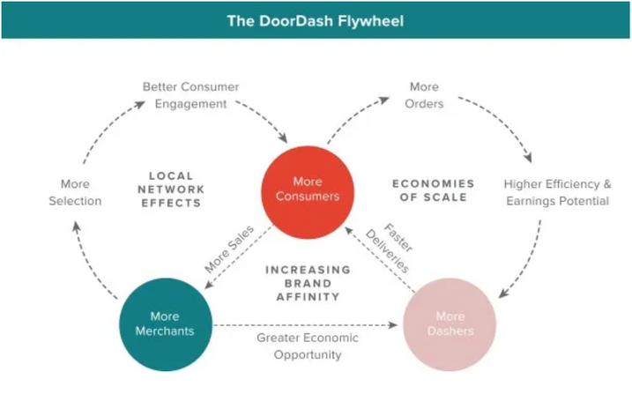
Exponential Growth
Grocery Delivery
Restaurant Technology solutions
Innovation and Logistics network
A clear strategy and operating model

Slide 17
Adjacent Growth
PHARMACY
BEAUTY
RETAIL
PACKAGE PICKUP
PETS
GIFTS

Slide 18


Market Strategy
FILLING THE GAP
DoorDash targets a Millennial-driven audience with a multifaceted strategy combining product innovation, social media marketing, and corporate responsibility. This includes 'Double Dash,' adding Target grocery deliveries in 2022, and providing partner restaurants real-time customer behavior analytics."
AUDIENCE SEGMENTATION
Door Dash's success comes from a clear audience segmentation , tailored communication to users and Restaurants, addressing distinct needs, and engaging Dashers through a dedicated app''.

Slide 19

Market Strategy
ADVANCED VALUE PROPOSITION
DoorDash's Drive app empowers partner Restaurants with customer insights, Dasher support, and brand value, giving them a competitive edge and streamlining operations for enhanced customer experiences.
A PANDEMIC-DRIVEN MARKET STRATEGY
DoorDash prioritized safety, supported Dashers, and assisted local businesses during the pandemic with protective gear, financial aid, and waived restaurant commission fees.

Slide 20
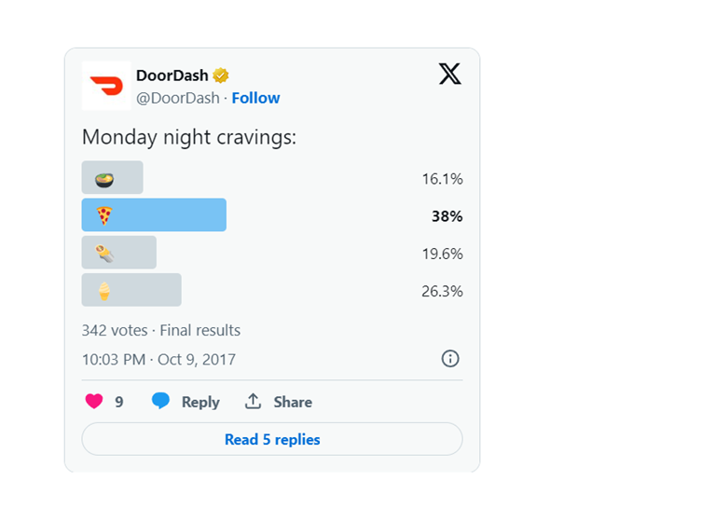
Creative Customer Engagement
Door Dash invests a lot of resources in building customer engagement via social media. In particular, the company uses interactive content to initiate conversations and strengthen relationships with customers.​
For example, a simple Twitter poll asking followers about their Monday night food cravings and thereby changing their plan on mondays to display more Pizza places

Slide 21
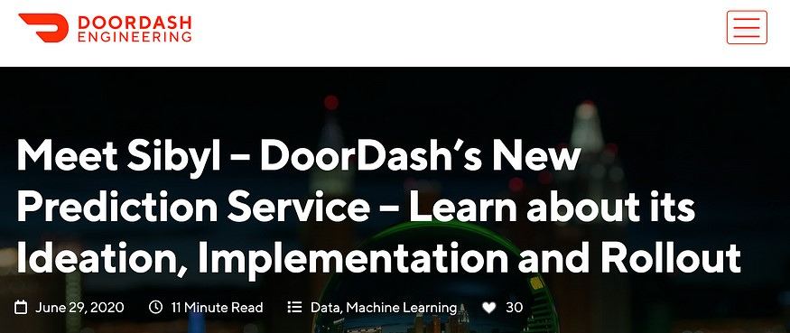
Data Driven Insights &Sentiment Analysis​
A data platform that drives intelligence and automation​
DoorDash has built an incredible analytics machine that allows granular optimization experiments on the tiniest little things across the food delivery lifecycle. At DoorDash, data is what drives the “Get 1% better every day” goal.​

Slide 22

DDD- Data & DoorDash
The secret is less in using data, but the decision to dedicate almost a third of all engineering resources to working with data.​
DoorDash has again a competitive advantage here — they have more customers and orders, across more markets, hence they have a better data set to power their machine learning algorithms. As a result, much of the DoorDash marketplace is now driven by data. Data makes the DoorDash ”Local Logistics platform more intelligent and efficient with every order”. It’s a huge competitive data moat. And to provide the scalability and flexibility to capture and process these huge amounts of data,

Slide 23
Critical Appreciation

Slide 24
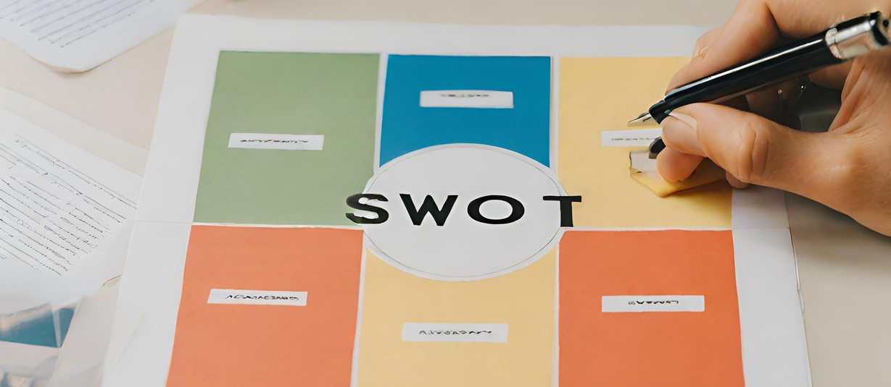
SWOT ANALYSIS
WEAKNESS
STRENGTH
THREATS
OPPORTUNITIES
Highly Competitive market
Regulatory Challenges
Negative Publicity
Leadership
Customer Base
Wide Value Offer
User Friendly Platform
Economic Downturn
Changes in Consumer Behavior
Data Privacy and Security
Expansion into New Markets
Develop new Tech
Acquire Competitors

Slide 25
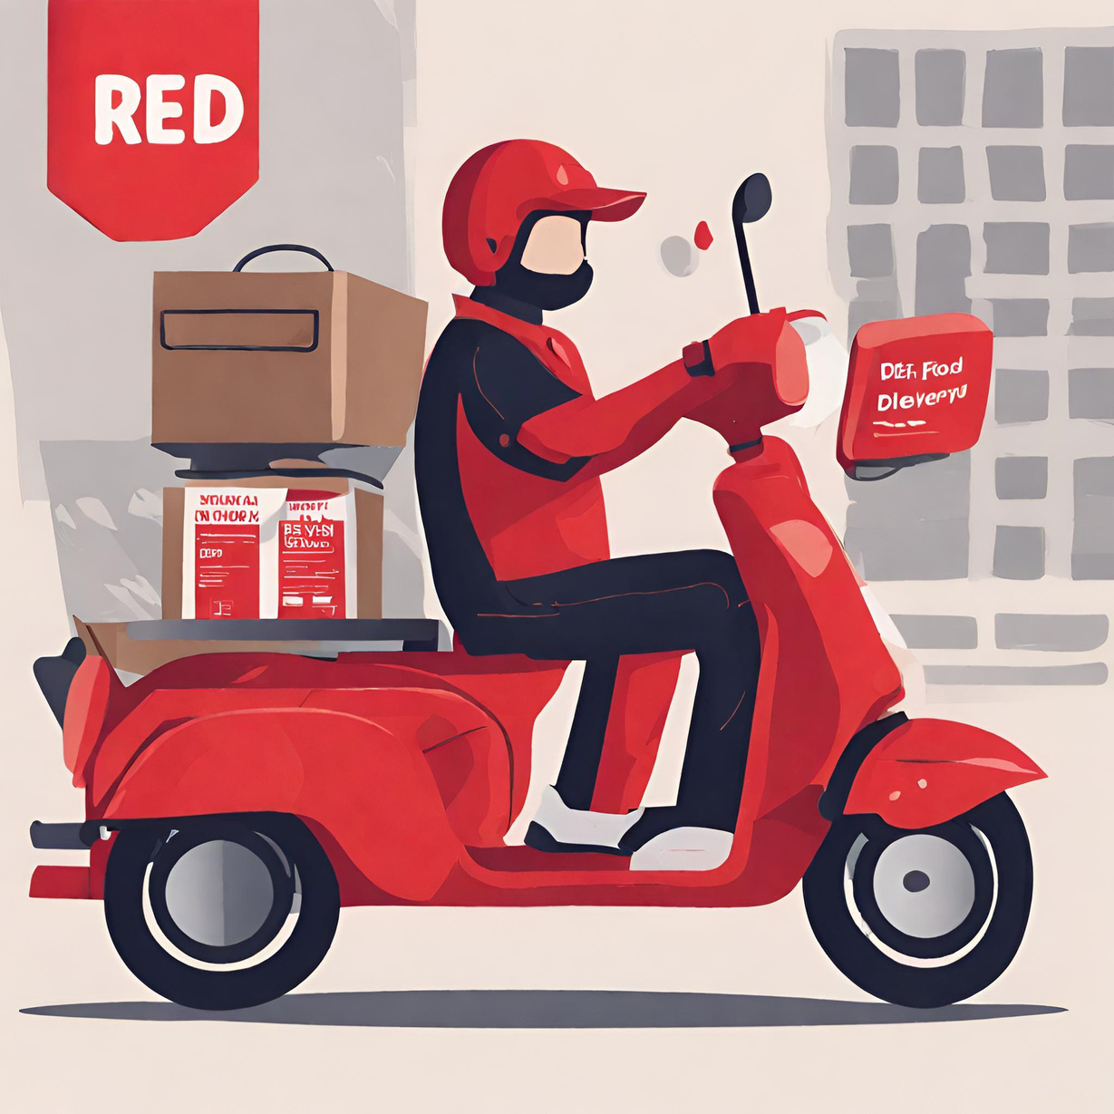
References
https://doordash.engineering/2020/09/25/how-doordash-is-scaling-its-data-platform/
https://www.businessofapps.com/data/doordash-statistics/​
​ https://resources.latana.com/post/doordash-success-story/
https://www.restaurantdive.com/news/how-grocery-retail-convenience-boost-doordash-momentum/637621/​
https://seekingalpha.com/article/4454354-doordash-strong-growth-moderating-with-no-upside-left
https:/larskamp.medium.com/how-doordash-built-the-most-incredible-go-to-market-playbook-ever-5e8f1d58f6cd

Slide 26
Thank you

